Slide 1

FMT Reversi
by
Francesco Benincasa
Matteo Franco
Tiziano Bonifazi

Slide 2

Roadmap
Intro
The project
Demo
Let’s dive into the code
Conclusions

Slide 3
Introduction
The aim of the project is to realize (in Java) Reversi game
The game rules are based on Reversi on Wikipedia and Federazione Nazionale Gioco Othello
The project has 3 target platforms:
Command line
Desktop
Android

Slide 4












The project - what did we use?

Slide 5

The project - what did we use?
Project is managed with Maven
OpenJDK 11 (for Android OpenJDK 8)
Github hosts project source code (IntelliJ git integration)
Issue were managed in github
Continuous Integration tools: Travis CI
Test coverage: Codecov
Code quality: SonarCloud
IDEs from JetBrains: IntelliJ, Android Studio

Slide 6
The project - what did we do?
Think!
We use agile methodology to develop the software
4 x 1 week sprint
One big briefing at week beginnig
Daily check
We (try to create) for each activity an issue
First phase had a bottom up approach (starting from documentation) to define entities
Following phases use a top down approach

Slide 7
The project - modules
Reversi-core
Reversi-desktop
Reversi-console
Reversi-android

Slide 8

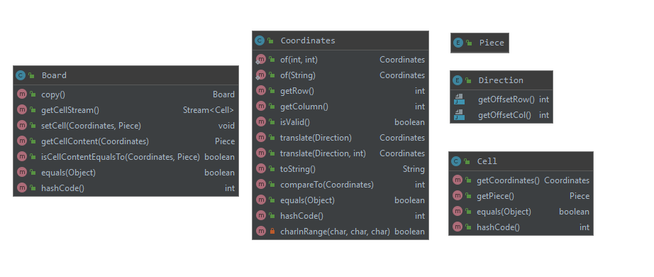
Entities – part 1

Slide 9
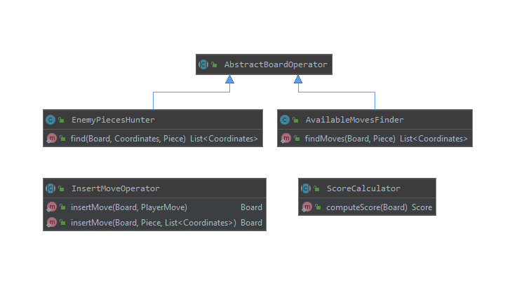
Entities – part 2

Slide 10
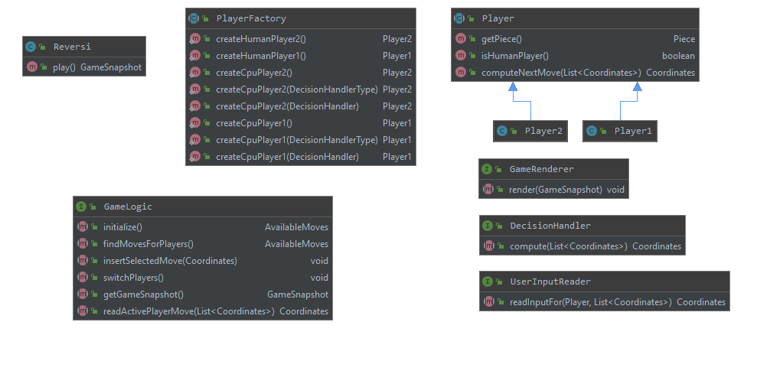
Entities – part 3

Slide 11

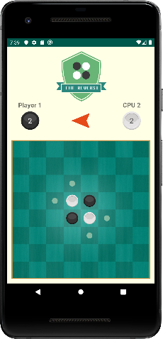
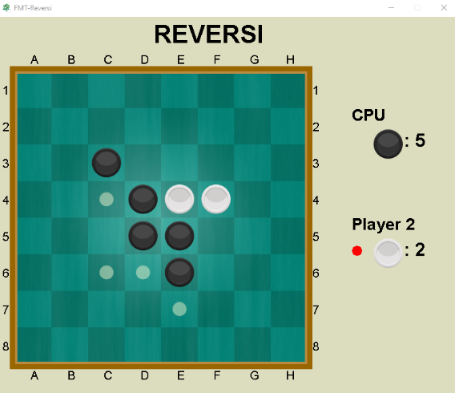
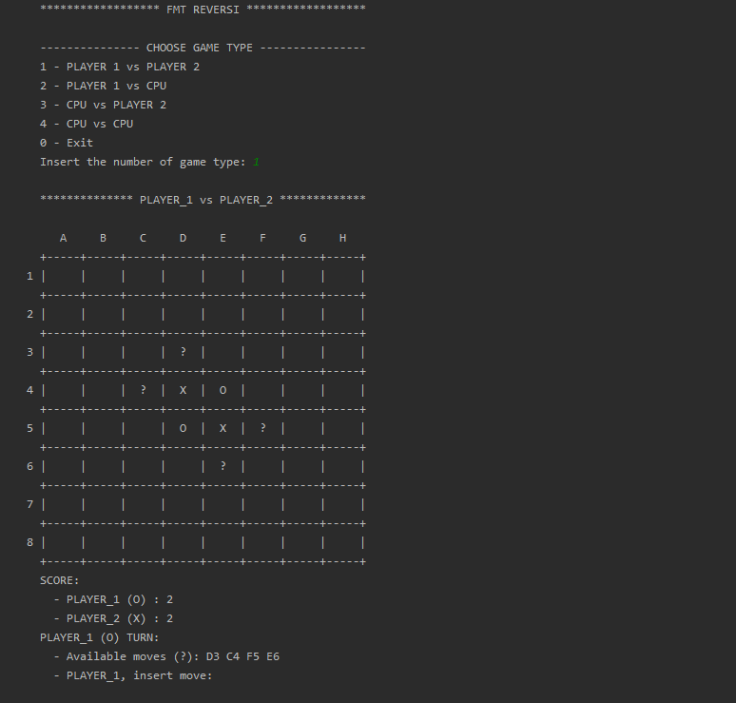
Demo
It’s time to play!
Android version available on Google Play Store
https://play.google.com/store/apps/details?id=it.fmt.games.reversi.android
Desktop and Console versions are ready to be run!

Slide 12
Some interesting links
FMT Reversi source code on Github
FMT Reversi Android source code on Github
Travis CI
CodeCov
SonarCloud

Slide 13
Conclusions
FMT Reversi can be improved:
Support for other platform (web)
Improved IA for CPU players
PS4 version cooming soon!
Any question?

Slide 14

Thanks!

